Slide 1
CHAPTER 2
SIMPLE REGRESSION

Slide 2
Outline
1. Regression analysis
2. Population Regression Function (PRF)
3. The meaning of term linear
4. Sample regression function (SRF)
5. The Method of Ordinary Least Squares (OLS)
6. The assumptions underlying the method of least squares
7. Precision or standard errors of least-square estimates
8. Properties of least squares estimators
9. A measure of “Goodness of fit”
10. Confidence intervals for regression coefficients and variance
11. Hypothesis testing: t-test, Chi square test and F-test
12. Some key points when reading the results
Notes:
We have a hard job. A biggest obstacle on the way to our goals!

Slide 3
1. Regression analysis
Galton’s law of universal regression: how the average height of sons changes, given the fathers’ height
The average height of children born of parents of given height tended to move or regress toward the average height in the population as a whole.
Notes:
The term regression was introduced by Galton. He found that there was a tendency for tall parents to have tall children, for short fathers to have short children. The average height of children born of parents of given height tended to move or regress toward the average height in the population as a whole. In other words the height of the children of unusually tall or unusually short parents tend to move toward the average height of the population.
Nghiên cứu của Francis Galton về chiều cao chiều cao của các bé trai với chiều cao của bố những đưa trẻ.
Với chiều cao đã biết của người cha thì chiều cao của con trai sẽ dao động quanh giá trị trung bình.
Chiều cao của cha tăng thì chiều cao của con trai cũng tăng.

Slide 4
1. Regression analysis
Notes:
Suppose we have a sample of fathers and sons’ height. One point indicates the height of a father and of his son. They are in inches. 1 inch = 2.54 centimes.
He found that there was a tendency for tall parents to have tall children, for short fathers to have short children. The average height of children born of parents of given height tended to move or regress toward the average height in the population as a whole. In other words the height of the children of unusually tall or unusually short parents tend to move toward the average height of the population.
This relationship between fathers and sons’ height is found by Galton. He introduced the term regression.
Is the study of the dependence of one variable, the dependent variable, on one or more other variables, the explanatory variables.
In other words, in regression analysis we estimate or predict the (population) mean value of the dependent variable on the basis of the known or fixed values of the explanatory variable(s).

Slide 5
1. Regression analysis?
Is the study of the dependence of one variable, the dependent variable, on one or more other variables, the independent variables.
To estimate the (population) mean or average value of the dependent variable on the basis of the known or fixed values of the independent variable(s).
One independent variable = simple regression
More than one independent variable = multiple regression
Notes:
Phân tích hồi quy là nghiên cứu mối liên hệ phụ thuộc của một biến được gọi là biến phụ thuộc (hay biến được giải thích) vào một hay nhiều biến khác - gọi là các biến độc lập (hay biến giải thích) nhằm ước lượng và/ hoặc dự báo giá trị trung bình (tổng thể) của biến phụ thuộc với các giá trị đã biết của các biến độc lập.

Slide 6

The Simple Regression Model
Definition of the simple linear regression model
Explains variable y in terms of variable x
Intercept
Slope parameter
Dependent variable,
explained variable,
response variable,…
Error term,
disturbance,
unobservables,…
Independent variable,
explanatory variable,
regressor,…
Notes:
Functional relationship between y and x. If u and beta 0 held fixed => change in u is zeo, then x has a liner function

Slide 7

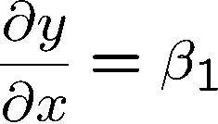
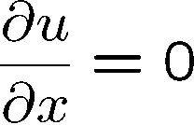
The Simple Regression Model
Interpretation of the simple linear regression model
The simple linear regression model is rarely applicable in prac-tice but its discussion is useful for pedagogical reasons
Studies how varies with changes in :
as long as
By how much does the dependent
variable change if the independent
variable is increased by one unit?
Interpretation only correct if all other
things remain equal when the indepen-
dent variable is increased by one unit
Notes:
The first order derivative of a function represents the rate of change of one variable with respect to another variable.

Slide 8
The Simple Regression Model
Example: Soybean yield and fertilizer
Example: A simple wage equation
Rainfall,
land quality,
presence of parasites, …
Measures the effect of fertilizer on
yield, holding all other factors fixed
Labor force experience,
tenure with current employer,
work ethic, intelligence …
Measures the change in hourly wage
given another year of education,
holding all other factors fixed

Slide 9
The significance of the stochastic error term
The error term is a representative for all those variables that are omitted from the model but that collectively affect Y.
Why don’t we introduce them into the model explicitly?
→ Vagueness of theory
→ Unavailability of data
→ Core variables versus peripheral variables
→ Principle of parsimony
→ Poor proxy variables
Notes:
peripheral variables: khong trong yeu
Parsimony: nguyen tac tiet kiem
1. Vagueness (‘veignis)of theory: The theory, if any, determining the behavior of Y may be, and often is, incomplete. We might be ignorant or unsure about the other variables affecting Y.
2. Unavailability of data: Lack of quantitative information about these variables, e.g., information on family wealth generally is not available.
3. Core variables versus peripheral variables: Assume that besides income X₁, the number of children per family X₂, sex X₃, religion X₄, education X₅, and geographical region X₆ also affect consumption expenditure. But the joint influence of all or some of these variables may be so small and it does not pay to introduce them into the model explicitly. One hopes that their combined effect can be treated as a random variable ui.
5. Poor proxy variables: for example, Friedman regards permanent consumption (Y_{p}) as a function of permanent income (X_{p}). But since data on these variables are not directly observable, in practice we use proxy variables, such as current consumption (Y) and current income (X), there is the problem of errors of measurement, u may in this case then also represent the errors of measurement.
6. Principle of parsimony: we would like to keep our regression model as simple as possible. If we can explain the behavior of Y “substantially” with two or three explanatory variables and if our theory is not strong enough to suggest what other variables might be included, why introduce more variables? Let u_{i} represent all other variables.
Nếu muốn đưa một biến vào mô hình phải giải thích tại sao biến đó cần được đưa vào (lí do) - theory
Có theory nhưng không đo lường được -> cần một biến đại diện khác để đo lường - proxy

Slide 10
3. The meaning of term linear
Linearity in the Variables
The conditional expectation of Y is a linear function of X_{i}, the regression curve in this case is a straight line. But
E(Y | X_{i}) = β₁ + β₂X²_{i} is not a linear function
Linearity in the Parameters
The conditional expectation of Y, E(Y | X_{i}), is a linear function of the parameters, the β’s; it may or may not be linear in the variable X.
E(Y | X_{i}) = β₁ + β₂X²_{i} is a linear (in the parameter) regression model.
The term “linear” regression will always mean a regression that is linear in the parameters.

Slide 11
Examples of linear regression models
Notes:
The term “linear” regression will always mean a regression that is linear in the parameters; the β’s (that is, the parameters are raised to the first power only).

Slide 12
Example
Table 2.1: a total population of 60 families and their weekly income (X) and weekly consumption expenditure (Y). The 60 families are divided into 10 income groups.

Slide 13
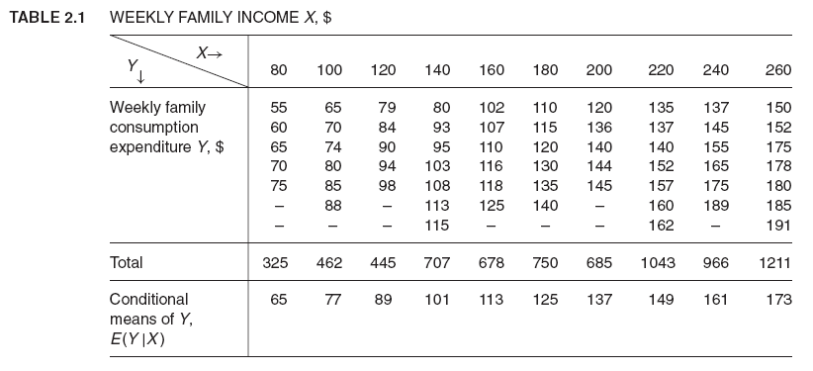
Notes:
Bảng 2.1: chi tiêu (Y) và thu nhập (X) của các hộ gia đình
Refer to a total population of 60 families and their weekly income (X) and weekly consumption expenditure (Y). The 60 families are divided into 10 income groups.
There is considerable variation in weekly consumption expenditure in each income group. But the general picture we can see is that, despite the variability of weekly consumption expenditure within each income bracket, on the average, weekly consumption expenditure increases as income increases.

Slide 14
Some findings
There is considerable variation in weekly consumption expenditure in each income group.
On the average, weekly consumption expenditure increases as income increases. → The dependence of consumption expenditure on income.

Slide 15
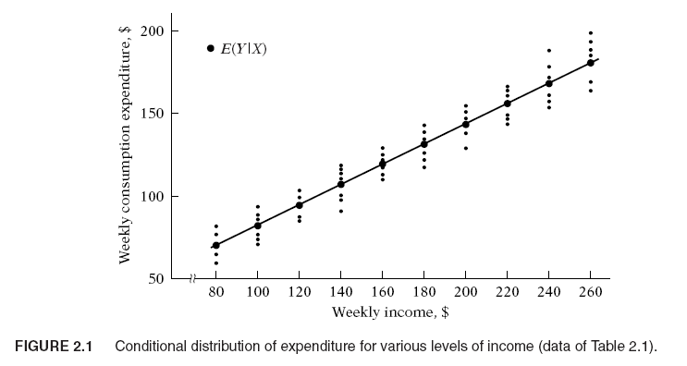
2. The population regression line (PRL)
Notes:
This figure provides clearer tendency. The dark circled points show the mean, or average weekly consumption expenditure corresponding to each of the 10 levels of income.
Conditional expected values
We call these mean values conditional expected values because they depend on the given values of variable X.
If we join these conditional mean values, we obtain the population regression line. More simply, it is the regression of Y on X.
→ The “population” comes from the fact that we are dealing in this example with the entire population of 60 families.

Slide 16
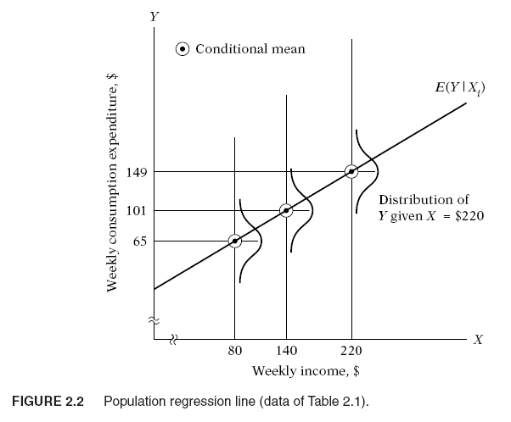
2. Population Regression Function (PRF)
Notes:
Given the income level of Xi, an individual family’s consumption expenditure is clustered around the average consumption of all family at that Xi.

Slide 17
2. Population Regression Function (PRF)
E(Y/X_{i})= f(X_{i}) → Population regression function (PRF) → How the mean or average response of Y varies with X.
The functional form of the PRF is an empirical question. For example, assume : E(Y | X_{i}) = β₁ + β₂X_{i.}
Our interest is in estimating the unknown beta 1, beta 2 on the basis of observations on Y and X.
Notes:
Each conditional mean E(Y | X_{i}) is a function of X_{i}: : E(Y/X_{i})= f(X_{i}) → known as the conditional expectation function (CEF) or population regression function (PRF) or population regression (PR) for short. → How the mean or average response of Y varies with X.
. For example, assume that the PRF E(Y | X_{i}) is a linear function of X_{i}, say, of the type
From the preceding discussion and Figures. 2.1 and 2.2, it is clear that each conditional mean E(Y | X_{i}) is a function of X_{i}. Symbolically,
Beta1, beta2 are unknown but fixed parameters- the regression coefficients. Beta 1 is known as intercept and beta2 is called slope coefficients.
In regression analysis, our interest is in estimating the PRFs, i.e., estimating the unknown beta 1, beta 2 on the basis of observations on Y and X.

Slide 18




Sample
In order to estimate the regression model one needs data
A random sample of n observations
First observation
Second observation
Third observation
Value of the dependent
variable of the i-th ob-
servation
Value of the expla-
natory variable of
the i-th observation
n-th observation

Slide 19
4. The Sample Regression Function (SRF)
A sample of Y values corresponding to some fixed X’s. Can we estimate the PRF from the sample data?
We may not be able to estimate the PRF “accurately” because of sampling fluctuations.
Suppose we draw another random sample from the population of Table 2.1, as presented in Table 2.4 and 2.5, we obtain the scatter-gram given in Figure 2.4.
Notes:
The data of Table 2.1 represent the population, not a sample. In most practical situations what we have is a sample of Y values corresponding to some fixed X’s.
Pretend that the population of Table 2.1 was not known to us and the only information we had was a randomly selected sample of Y values for the fixed X’s as given in Table 2.4. each Y (given X_{i}) in Table 2.4 is chosen randomly from similar Y’s corresponding to the same X_{i} from the population of Table 2.1.
Can we estimate the PRF from the sample data? We may not be able to estimate the PRF “accurately” because of sampling fluctuations. To see this, suppose we draw another random sample from the population of Table 2.1, as presented in Table 2.5. Plotting the data of Tables 2.4 and 2.5, we obtain the scattergram given in Figure 2.4. In the scattergram two sample regression lines are drawn so as

Slide 20
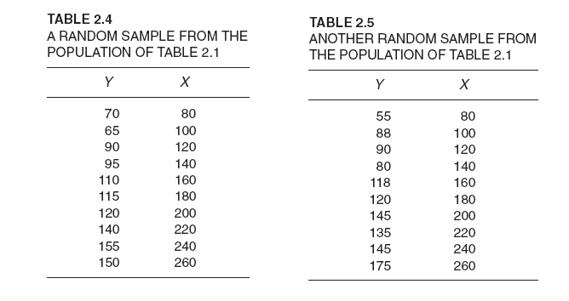
4. The Sample Regression Function (SRF)
Notes:
The data of Table 2.1 represent the population, not a sample. In most practical situations what we have is a sample of Y values corresponding to some fixed X’s.
Pretend that the population of Table 2.1 was not known to us and the only information we had was a randomly selected sample of Y values for the fixed X’s as given in Table 2.4. each Y (given X_{i}) in Table 2.4 is chosen randomly from similar Y’s corresponding to the same X_{i} from the population of Table 2.1.
Can we estimate the PRF from the sample data? We may not be able to estimate the PRF “accurately” because of sampling fluctuations. To see this, suppose we draw another random sample from the population of Table 2.1, as presented in Table 2.5. Plotting the data of Tables 2.4 and 2.5, we obtain the scattergram given in Figure 2.4. In the scattergram two sample regression lines are drawn so as

Slide 21
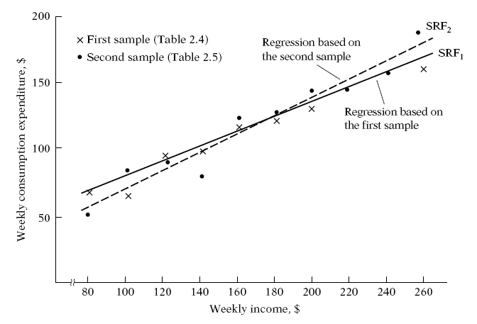
4. The Sample Regression Function (SRF)
Notes:
Which of the two regression lines represents the “true” population regression line? There is no way we can be absolutely sure that either of the regression lines shown in Figure 2.4 represents the true population regression line (or curve). Supposedly they represent the population regression line, but because of sampling fluctuations they are at best an approximation of the true PR. In general, we would get N different SRFs for N different samples, and these SRFs are not likely to be the same.

Slide 22
4. The Sample Regression Function (SRF)
Population regression function
Sample regression function
Yˆ_{i} = estimator of E(Y | X_{i})
βˆ₁ = estimator of β₁
βˆ₂ = estimator of β₂
An estimator, also known as a (sample) statistic, is simply a rule or formula or method that tells how to estimate the population parameter from the information provided by the sample.
A particular numerical value obtained by the estimator in an application is known as an estimate.
Notes:
We can develop the concept of the sample regression function (SRF) to represent the sample regression line. The sample counterpart of (2.2.2) may be written as
Yˆ_{i} = βˆ₁ + βˆ₂X_{i} (2.6.1)
where Yˆ is read as “Y-hat’’ or “Y-cap’’
Yˆ_{i} = estimator of E(Y | X_{i}) – conditional mean of Y given a level of Xi
βˆ₁ = estimator of β₁
βˆ₂ = estimator of β₂
Note that an estimator, also known as a (sample) statistic, is simply a rule or formula or method that tells how to estimate the population parameter from the information provided by the sample at hand.
A particular numerical value obtained by the estimator in an application is known as an estimates.

Slide 23
4. The Sample Regression Function (SRF)
The stochastic form of SRF:
ˆu_{i} = the (sample) residual term.
Conceptually ˆu_{i} is analogous to u_{i} and can be regarded as an estimate of u_{i}. It is introduced in the SRF for the same reasons as u_{i} was introduced in the PRF.
Notes:
ˆu_{i} denotes the (sample) residual term. Conceptually ˆu_{i} is analogous to u_{i} and can be regarded as an estimate of u_{i}. It is introduced in the SRF for the same reasons as u_{i} was introduced in the PRF.

Slide 24
4. The Sample Regression Function (SRF)
Our primary objective in regression analysis is to estimate the PRF
On the basis of the SRF
How should the SRF be constructed so that βˆ₁ is as “close” as possible to the true β₁ and βˆ₂ is as “close” as possible to the true β₂ even though we will never know the true β₁ and β₂?
Notes:
because more often than not our analysis is based upon a single sample from some population. But because of sampling fluctuations our estimate of the PRF based on the SRF is at best an approximate one.
The critical question now is: Granted that the SRF is but an approximation of the PRF, can we devise a rule or a method that will make this approximation as “close” as possible? In other words, how should the SRF be constructed so that βˆ₁ is as “close” as possible to the true β₁ and βˆ₂ is as “close” as possible to the true β₂ even though we will never know the true β₁ and β₂?

Slide 25
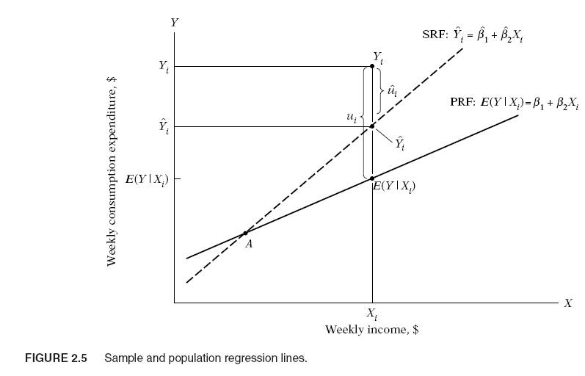
The SRF is an approximation of the PRF
Notes:
Can we have a rule or a method that will make this approximation as “close” as possible?

Slide 26
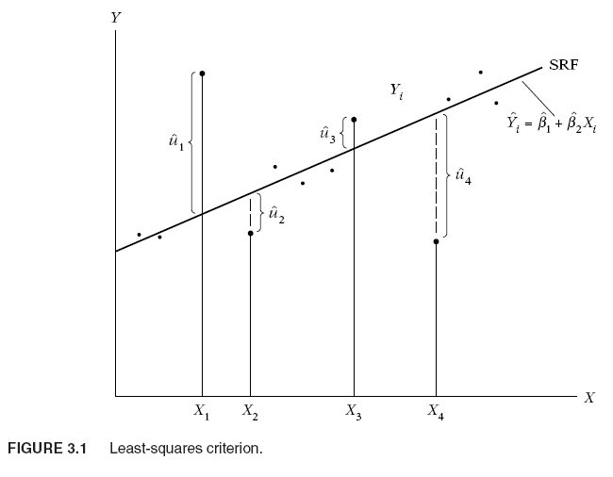
5. The method of Ordinary Least Squares (OLS)
Notes:
Fit as good as possible a regression line through the data points:

Slide 27

5. The method of Ordinary Least Squares (OLS)
Two-variable PRF:
The PRF is not directly observable. We estimate it from the SRF:
Or
The residuals are the differences between the actual and estimated Y values.
$$\hat{Y_{i}}=\hat{β_{1}}+\hat{β_{2}}X_{i}$$
Notes:
X_{i} và Y_{i} là trị quan sát thứ i của biến độc lập và biến phụ thuộc X và Y, α và β là các tham số chưa biết sẽ được ước lượng và được gọi là hệ số hồi quy, U_{i} là số hạng sai số không quan sát được và được giả định là biến ngẫu nhiên.

Slide 28
5. The method of Ordinary Least Squares (OLS)
Given n pairs of observations on Y and X, we would like to determine the SRF in such a manner that it is as close as possible to the actual Y. To this end, we may adopt the following criterion:
Choose the SRF in such a way that the sum of the residuals or Q is as small as possible.
Notes:
where ˆu²_{i} are the squared residuals.

Slide 29
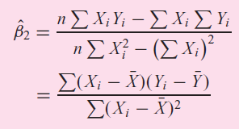
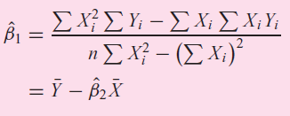
5. The Method of Ordinary Least Squares

Slide 30
5. The method of Ordinary Least Squares (OLS)
CEO Salary and return on equity
Fitted regression
Causal interpretation?
Salary in thousands of dollars
Return on equity of the CEO‘s firm
If the return on equity increases by 1 percent,
then salary is predicted to change by 18,501 $

Slide 31
5. The method of Ordinary Least Squares (OLS)
Wage and education
Fitted regression
Hourly wage in dollars
Years of education
Intercept
In the sample, one more year of education was
associated with an increase in hourly wage by 0.54 $
Notes:
If edu=0?

Slide 32


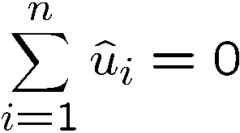
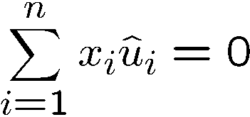

5. The method of Ordinary Least Squares (OLS)
Properties of OLS on any sample of data
Fitted values and residuals
Algebraic properties of OLS regression
If u>0
And if u<0
Fitted or predicted values
Deviations from regression line (= residuals)
Deviations from regression line sum up to zero
Correlation between deviations and regressors is zero
Sample averages of y and x lie on regression line

Slide 33
6. The assumptions underlying the OLS
Assumptions 1: Linear in Parameters. The regression model is linear in the parameters.
Notes:
We first discuss these assumptions in the context of the two-variable regression model. In the following chapter, we extend them to multiple regression models.

Slide 34
6. The assumptions underlying the OLS
Assumption 2: X values are fixed in repeated samplings. X is assumed to be non-stochastic.
Keeping the value of income X fixed, say, at $80, we draw at random a family and observe its weekly family consumption expenditure Y as, say, $60. Still keeping X at $80, we draw at random another family and observe its Y value as $75. In each of these drawings (i.e., repeated sampling), the value of X is fixed at $80.
Our regression analysis is conditional regression analysis, that is, conditional on the given values of the regressor(s) X.
Notes:
We first discuss these assumptions in the context of the two-variable regression model. In the following chapter, we extend them to multiple regression models.

Slide 35
6. The assumptions underlying the OLS
Assumptions 3: Zero mean value of disturbance
Each Y population corresponding to a given X is distributed around its mean value with some Y values above the mean and some below it. The mean value of these deviations corresponding to any given X should be zero.
Note that the assumption E(u_{i} | X_{i}) = 0 implies that E(Y_{i} | X_{i}) = β₁ + β₂X_{i}.
Notes:
We first discuss these assumptions in the context of the two-variable regression model. In the following chapter, we extend them to multiple regression models.

Slide 36
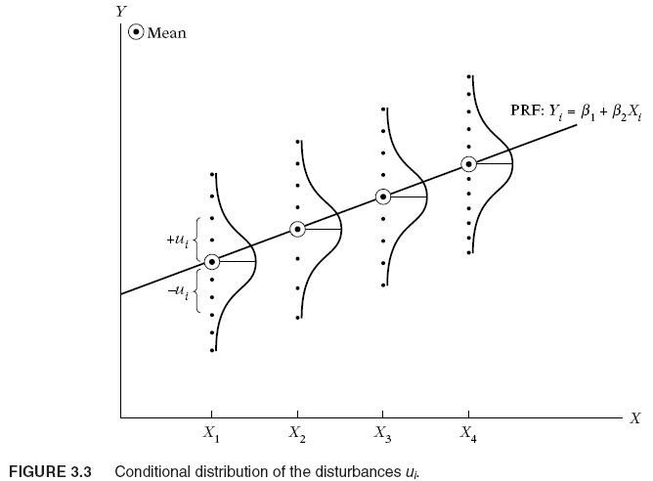
Assumption 3
E(u_{i} | X_{i}) = 0

Slide 37
6. The assumptions underlying the OLS
Assumption 4: Homoscedasticity or equal variance of disturbance
The variation around the regression line (which is the line of average relationship between Y and X) is the same across the X values; it neither increases or decreases as X varies
Notes:
We first discuss these assumptions in the context of the two-variable regression model. In the following chapter, we extend them to multiple regression models.
- Homoscedasticity: hiệp phương sai không đồng nhất

Slide 38
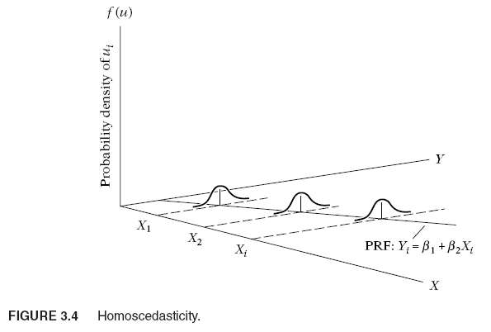

Slide 39
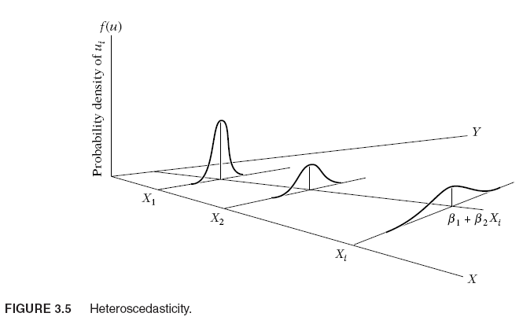
Notes:
Tests for heteroscedasticity: Goldfeld-Quandt test, White’s test
If the form of heteroscedasticity is known, we can use Generalized Least Squares (GLS) to estimate the model.

Slide 40
6. The assumptions underlying the OLS
Assumption 5: No autocorrelation between the disturbance: , i≠j.
The disturbances u_{i} and u_{j} are uncorrelated, i.e., no serial correlation. This means that, given X_{i} , the deviations of any two Y values from their mean value do not exhibit patterns.
Ex: (Y_{t} = β₁ + β₂X_{t} + u_{t}) that u_{t} and u_{t−1} are positively correlated. Then Y_{t} depends not only on X_{t} but also on u_{t−1} for u_{t−1} to some extent determines u_{t}.
We will see how intercorrelations among the disturbances can brought into the analysis and with what consequences.

Slide 41
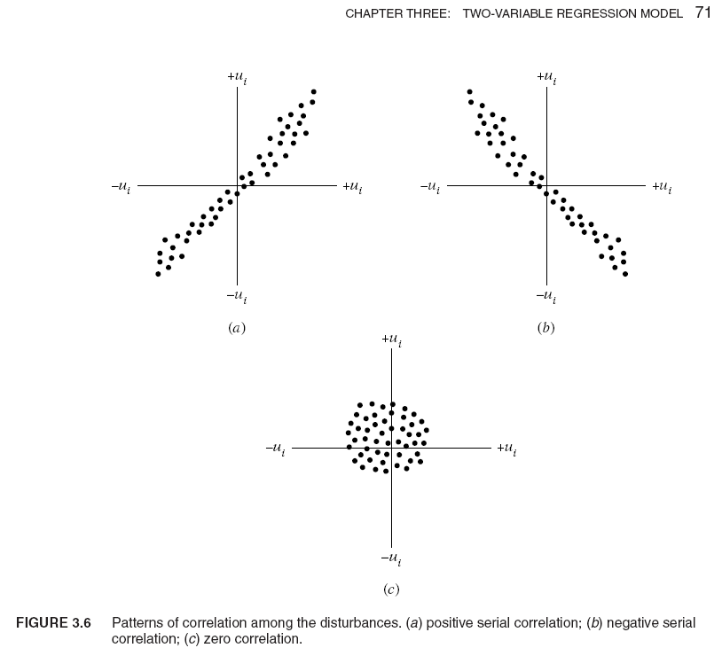
Notes:
In Figure 3.6a, the u’s are positively correlated, a positive u followed by a positive u or a negative u followed by a negative u.
In Figure 3.6b, the u’s are negatively correlated, a positive u followed by a negative u and vice versa.
If the disturbances follow systematic patterns, Figure 3.6a and b, there is auto- or serial correlation. Figure 3.6c shows that there is no systematic pattern to the u’s, thus indicating zero correlation.

Slide 42
6. The assumptions underlying the OLS
Assumption 6: Zero covariance between ui and Xi
The disturbance u and explanatory variable X are uncorrelated. The PRF assumes that X and u (which may represent the influence of all the omitted variables) have separate (and additive) influence on Y. But if X and u are correlated, it is not possible to assess their individual effects on Y.
Notes:
Two alternative methods: Instrumental Variables (IV) and Generalized Method if Moments (GMM)
Thus, if X and u are positively correlated, X increases when u increases and it decreases when u decreases. Similarly, if X and u are negatively correlated, X increases when u decreases and it decreases when u increases. In either case, it is difficult to isolate the influence of X and u on Y.

Slide 43
6. The assumptions underlying the OLS
Assumption 7: The number of observations n must be greater than the number of parameters to be estimated.
Assumption 8: Variability in X values. The X values in a given sample must not all be the same.

Slide 44
6. The assumptions underlying the OLS
Assumption 9: The regression model is correctly specified. There is no specification bias or error in the model used in empirical analysis.
Some important questions that arise in the specification of the model include the following:
(1) What variables should be included in the model?
(2) What is the functional form of the model? Is it linear in the parameters, the variables, or both?
(3) What are the probabilistic assumptions made about the Y_{i} , the X_{i}, and the u_{i} entering the model?
Notes:
An econometric investigation begins with the specification of the econometric model underlying the phenomenon of interest. Some important questions that arise in the specification of the model include the following:

Slide 45
An example of assumption 9
Two models depict the underlying relationship between the rate of change of money wages and the unemployment rate:
Y_{i} = α₁ + α₂X_{i} + u_{i}
Y_{i} = β₁ + β₂ (1/X_{i} ) + u_{i}
If the second model is the “correct” or the “true” model, fitting the first one to the scatterpoints shown in Figure 3.7 will give us wrong predictions.
Notes:
Suppose we choose the following two models to depict the underlying relationship between the rate of change of money wages and the unemployment rate:
where Y_{i} = the rate of change of money wages, and X_{i} = the unemployment rate. The regression model (3.2.7) is linear both in the parameters and the variables, whereas (3.2.8) is linear in the parameters (hence a linear regression model by our definition) but nonlinear in the variable X. Now consider Figure 3.7.
If model (3.2.8) is the “correct” or the “true” model, fitting the model (3.2.7) to the scatterpoints shown in Figure 3.7 will give us wrong predictions.
Unfortunately, in practice one rarely knows the correct variables to include in the model or the correct functional form of the model or the correct probabilistic assumptions about the variables entering the model for the theory underlying the particular investigation may not be strong or robust enough to answer all these questions.

Slide 46
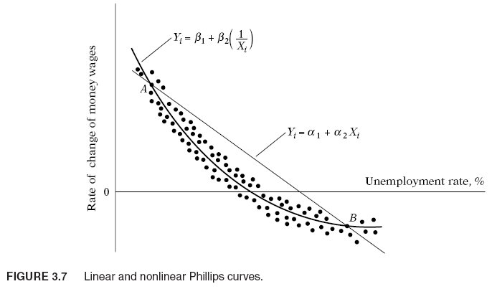

Slide 47
6. The assumptions underlying the OLS
Assumption 10: There is no perfect multicollinearity.
That is, there are no perfect linear relationships among the independent variables.
→ We will discuss in the multiple regression models.

Slide 48
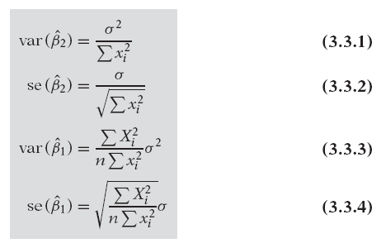
7. Precision or standard errors of Least-Squares estimates
The least-squares estimates are a function of the sample data.
To measure the reliability or precision of the estimators βˆ₁ and βˆ₂:
Notes:
But since the data change from sample to sample, the estimates will change. Therefore, what is needed is some measure of “reliability” or precision of the estimators βˆ₁ and βˆ₂. In statistics the precision of an estimate is measured by its standard error (se), which can be obtained as follows:
See Appendix 3A3, (101)
xi^2=(Xi-Xbar)^2

Slide 49


7. Precision or standard errors of Least-Squares estimates
σ² is the constant or homoscedastic variance of u_{i}
Where:
ˆσ² is the OLS estimator of the true but unknown σ² and where the expression n−2 is known as the number of degrees of freedom (df).
is the residual sum of squares (RSS).
See 3.5.2, 83

Slide 50


Properties of OLS Estimators
With the assumption that ui follow the normal distribution, the OLS estimators have the following properties:

Slide 51
Example
Wage and education (WAGE1.dta)
Notes:
SE(educ) = 0.0532
SE(beta1_ = 0.6849
RSS= 5980.6822
Sigma^2= 11.41 (MSE)
twoway scatter wage educ
. graph twoway lfit wage educ
. graph twoway (lfit wage educ) (scatter wage educ)
The Root MSE, or root mean squared error (sigma)

Slide 52
8. Properties of OLS statistics
LEC 5
The sum and the sample average of the OLS residuals is zero.
The sample covariance between the regressors and the OLS residuals is zero.
The point is always on the OLS regression line.
(See Appendix 3A.1, p100)

Slide 53
8. Properties of least-squares estimators
Gauss-Markov Theorem: Given the assumptions of the classical linear regression model, the least-squares estimators in the class of unbiased linear estimators, have minimum variance, that is, they are BLUE. (BLUE- Best Linear Unbiased Estimator).

Slide 54
9. A measure of “Goodness of fit”
The goodness of fit: how “well” the sample regression line fits the data.
The coefficient of determination r² (two-variable case) or R² (multiple regression) is a summary measure that tells how well the sample regression line fits the data.
Notes:
We now consider the goodness of fit of the fitted regression line to a set of data; that is, we shall find out how “well” the sample regression line fits the data. The coefficient of determination r² (two-variable case) or R² (multiple regression) is a summary measure that tells how well the sample regression line fits the data.
Consider a heuristic explanation of r² in terms of a graphical device, known as the Venn diagram shown in Figure 3.9.
In this figure the circle Y represents variation in the dependent variable Y and the circle X represents variation in the explanatory variable X. The overlap of the two circles indicates the extent to which the variation in Y is explained by the variation in X.

Slide 55
Properties of OLS
Fitted values and residuals
Algebraic properties of OLS regression
If u>0
And if u<0
Fitted or predicted values
Deviations from regression line (= residuals)
Deviations from regression line sum up to zero
Sample averages of y and x lie on regression line
Correlation between deviations and regressors is zero

Slide 56

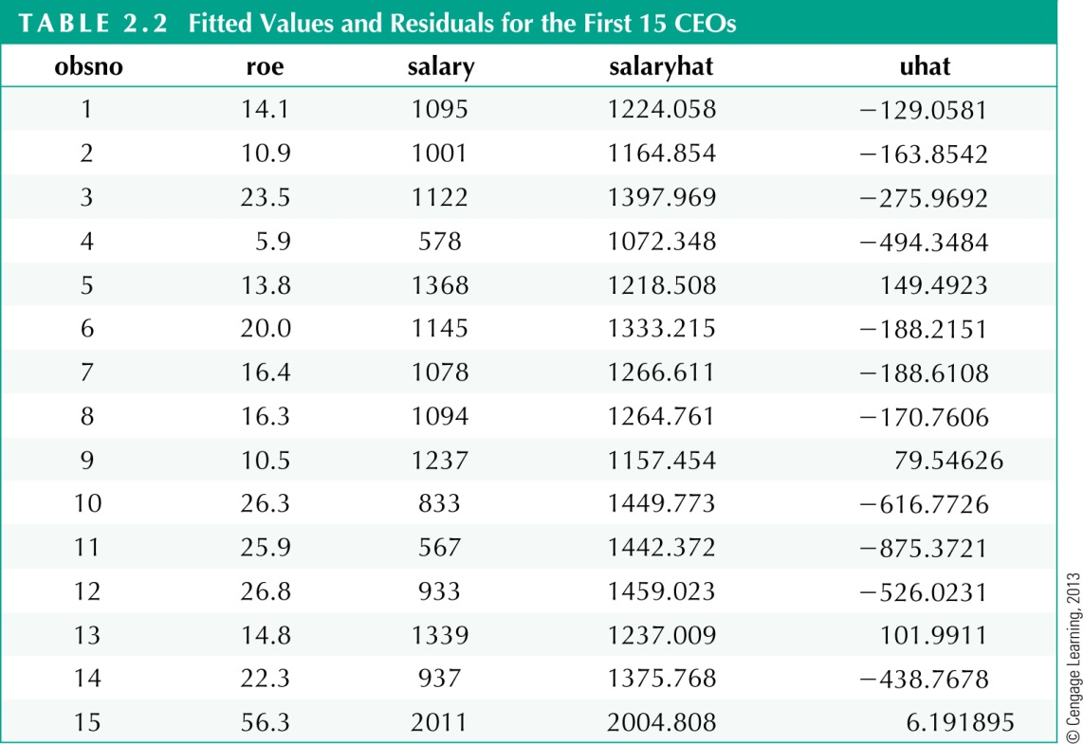



Properties of OLS
For example, CEO number 12‘s salary was 526,023 $ lower than predicted using the the information on his firm‘s return on equity

Slide 57
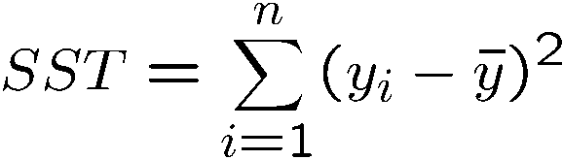
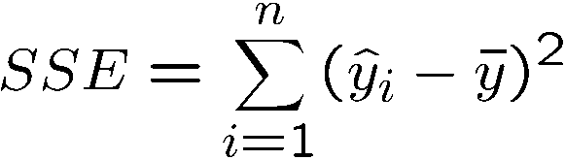
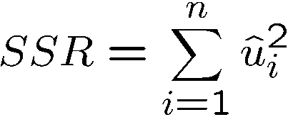
9. A measure of “Goodness of fit”
Goodness-of-Fit
Measures of Variation
How well does the explanatory variable explain the dependent variable?
Total sum of squares,
represents total variation
in dependent variable
Explained sum of squares,
represents variation
explained by regression
Residual sum of squares,
represents variation not
explained by regression

Slide 58
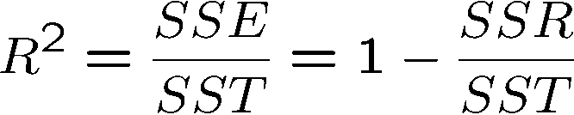
9. A measure of “Goodness of fit”
Decomposition of total variation
Goodness-of-fit measure (R-squared)
Total variation
Explained part
Unexplained part
R-squared measures the fraction of the total variation that is explained by the regression. → 0 ≤ r² ≤ 1
Notes:
TSS = ESS +RSS

Slide 59
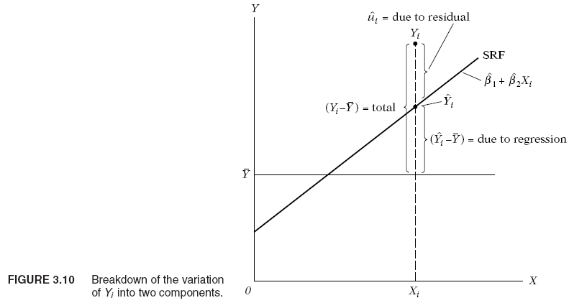
9. A measure of “Goodness of fit”

Slide 60
Example
CEO salary and ROE (CEOSAL1.DTA)
Notes:
Calculate R2 based on TSS and RSS

Slide 61
10. Confidence intervals for regression coefficients
LEC 6
and follow the t distribution with (n-2) df
100(1-α)% confidence intervals for the coefficients:
Notes:
Cần giải thích là tại sao theo phân phối t mà không phải là Z (chuẩn tắc)
Vì Se(b1) không biết, dùng uhat để ước lượng.
T= (estimator- parameter)/se
Such an interval, if it exists, is known as a confidence interval; 1 − α is
known as the confidence coefficient; and α (0 < α < 1) is known as the
level of significance.
the width of the confidence interval is proportional
to the standard error of the estimator. That is, the larger the standard error,
the larger is the width of the confidence interval. Put differently, the larger
the standard error of the estimator, the greater is the uncertainty of estimating
the true value of the unknown parameter. the standard error of an estimator is often described as a measure of the precision of the estimator,
i.e., how precisely the estimator measures the true population value

Slide 62
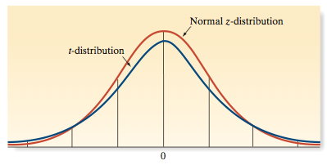
Student’s t-Statistic
The t-statistic is similar to z-statistic: mound-shaped, symmetric, with mean 0.

Slide 63
Student’s t Distribution
Standard Normal
Bell-Shaped
Symmetric
‘Fatter’ Tails
t (df = 13)
t (df = 5)
z
t
0

Slide 64
Student’s t Distribution
Critical Value(s):
.025
.025
-1.96
0
1.96
t

Slide 65
Fill in the blank with the correct numbers
Critical value: t(524, 0.025)= 1.96
use "D:\Bai giang\Kinh te luong\datasets\WAGE1.DTA", clear

Slide 66
10. Confidence intervals for variance
We have :
→ 100(1-α)% confidence intervals for the variance

Slide 67
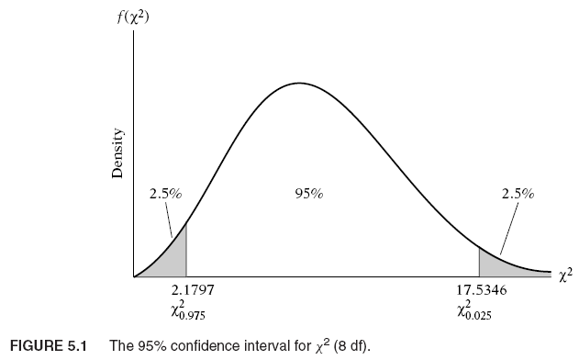
10. Confidence intervals for variance
(Note the skewed characteristic of the chi-square distribution.)

Slide 68
11. Hypothesis testing
Hypotheses:
Two-tail test:
Right- tail test:
Left-tail test:
Notes:
Null hypothesis and alternative hypothesis

Slide 69
11. Hypothesis testing-t test
The t Test: The decision to accept or reject H0 is made on the basis of the value of the test statistic obtained from the data at hand.
Recall follows the t
distribution (n-2) df.

Slide 70
11. Hypothesis testing- t test
Compute t-statistics :
The decision to accept or reject H0
- Two-tail test: |t₀|>t_{(n-2),α/2} → reject H₀
- Right-tail test : t₀ > t_{(n-2),α} → reject H₀.
- Left-tail test: t₀ <- t_{(n-2),α} → reject H₀
Notes:
display invttail(500,0.025) → tim t statistics
. display 1- ttail(526,-1.32) → Tim p value, one-tail
display ttail(526,1.32)
.09370459
. display 2*(1-ttail(526,-1.32)) → Two tails
.18740917

Slide 71
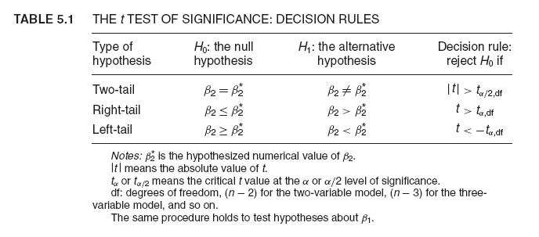

Slide 72
Test H0: beta2=0.3
Critical value: t(524, 0.025)= 1.96
use "D:\Bai giang\Kinh te luong\datasets\WAGE1.DTA", clear
Notes:
di invttail(522,0.05)
di invFtail(1,522,0.05)

Slide 73
Decision rule
Construct a confidence interval for beta. If the beta under H0 falls within this confidence interval, do not reject H0, but if it falls outside this interval, reject H0.

Slide 74
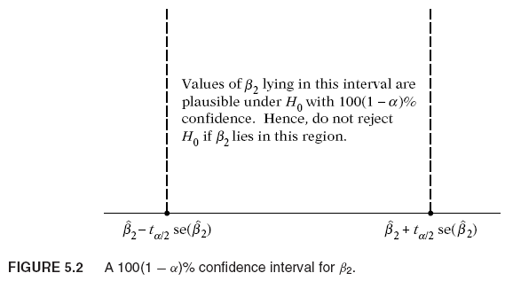

Slide 75
Practical aspects- meaning of “accepting” or “rejecting”
If on the basis of a test of significance, we decide to “accept” the null hypothesis, all we are saying is that on the basis of the sample evidence we have no reason to reject it, we are not saying that the null hypothesis is true beyond and doubt.

Slide 76
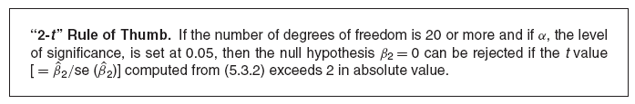
Practical aspects: The “Zero” Null Hypothesis and the “2-t” Rule of Thumb
A null hypothesis that is commonly tested in empirical work is H₀: β₂ = 0, that is, the slope coefficient is zero.
This null hypothesis can be easily tested by the confidence interval or the t-test approach discussed in the preceding sections. But very often such formal testing can be shortcut by adopting the “2-t” rule of significance, which may be stated as

Slide 77
Example- One tail test
Suppose economic theory suggests that the marginal propensity to consume is greater than 0.3.
We have , t=5.857 → Reject H0.

Slide 78
11. Hypothesis testing- Chi-square test
The Chi-square test: Testing the significance of variance
Two-tail test:
Right-tail test:
Left-tail test:
Compute:

Slide 79
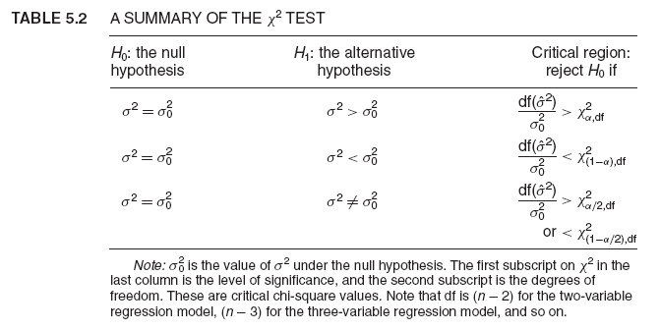

Slide 80
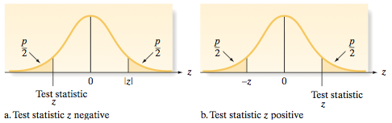
11. Hypothesis Testing- p-value
Obtain t-stat or z-stat
Obtain the p-value
Compare the p-value with α
If p-value < α , reject H₀
If p-value ≥ α , do not reject H₀
Reject H
Reject H
0
0
.025
.025
-1.96
0
1.96
t

Slide 81
11. Hypothesis testing-F test
F test: testing the significance of the model
Hypothesis: H₀: R²=0, H₁: R²>0
We have:
Thus
follows the F distribution, (1, n-2) df.
Step 1: Compute or
If → Reject H0.

Slide 82
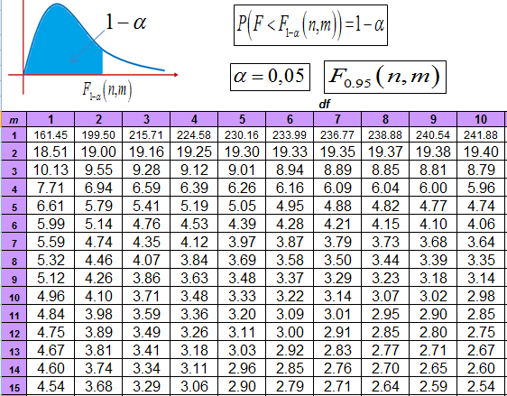

Slide 83
12. Read the results
Test the model: look at F test → If p-value is smaller than alpha, the model is significant.
Test the goodness of fit of the model: look at R-square → It measures the proportion or percentage of the total variation in Y explained by the regression model. If the model is significant but R-square is small, it means that observed values are widely spread around the regression line.
Test that the slope is significantly different from zero: Look at t-value in the ‘Coefficients’ table and find p-value. Are the signs of the estimated coefficients in accordance with theoretical or prior expectations?

Slide 84
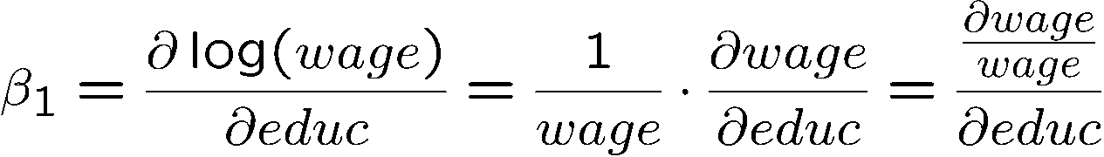
Semi-logarithmic form
Regression of log wages on years of eduction
This changes the interpretation of the regression coefficient:
Natural logarithm of wage
Percentage change of wage
… if years of education
are increased by one year

Slide 85
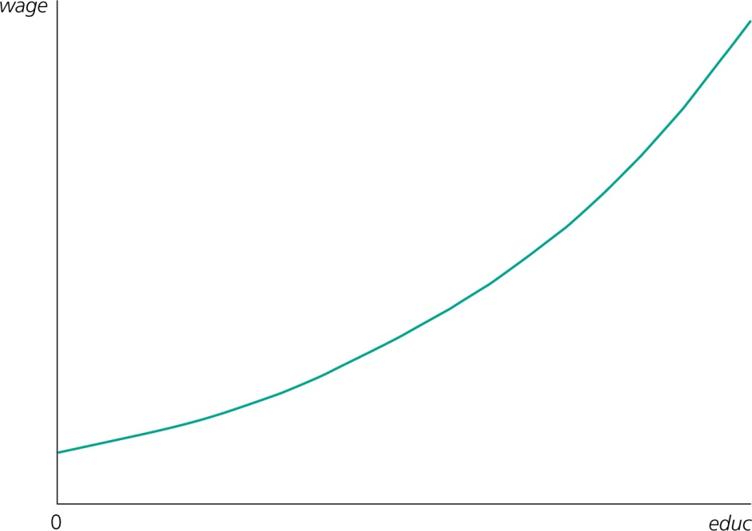
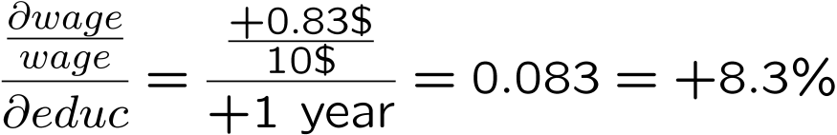
Semi-logarithmic form
Fitted regression
The wage increases by 8.3 % for
every additional year of education
(= return to education)
For example:
Growth rate of wage is 8.3 %
per year of education

Slide 86
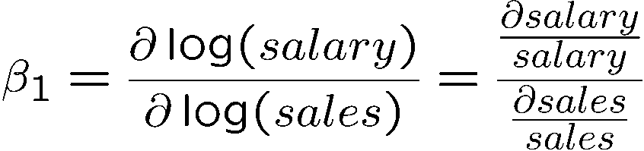
Log-logarithmic form
CEO salary and firm sales
This changes the interpretation of the regression coefficient:
Percentage change of salary
… if sales increase by 1 %
Logarithmic changes are
always percentage changes

Slide 87
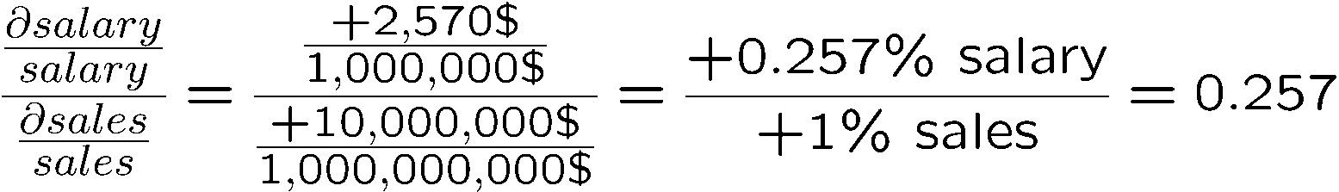
Log-logarithmic form
CEO salary and firm sales: fitted regression
For example:
+ 1 % sales ! + 0.257 % salary

